Slide 1
Video Game Genres
By: Caitlyn Hutson and Griffin Hanson

Slide 2
Common Genres in Gaming
“Abstract, Adaptation, Adventure, Artificial Life, Ball-and-Paddle, Board Games, Capturing, Card Games, Catching, Chase, Collecting, Combat, Demo, Diagnostic, Dodging, Driving , Educational, Escape, Fighting, Flying, Gambling, Interactive Movie, Maze, Obstacle Course, Pencil-and-Paper Games, Pinball, Platform, Programming Games, Puzzle, Quiz, Racing, Rhythm and Dance, Role-Playing, Shooting, Sports, Strategy, Table-Top Games, Target, Text Adventure, Training Simulation, and Utility.” (Wolf)
Others: Sandbox- encompass many aspects of multiple genres, usually with free play option (Ex: GTA), Simulation- games trying to get as close to real life through management of resources (Ex: Sim City, Civilization)
Video game genres are categorized differently than literary or film genres as their interactivity (player’s involvement) weighs heavily on how the game is played. It is not determined solely by setting or content.

Slide 3
Massively Multiplayer Online RPG(MMOs)
games that involve “a huge community of players all operating within the same game-world subject to the same rules” (Wolf) usually fighting towards the same goals.
Involves making and building a character over an unprecedented amount of time. Even when a max level is reached, other DLC or areas of the world become available, giving the player incentive to keep playing.
Usually has a player based economy, which allows players to buy and trade supplies with each other rather than relying solely on what the game’s “store” offers.
Inspires community building, teamwork, and comradery. Ex: Robin Williams WOW tribute http://www.wowhead.com/news=242980/robin-williams-genie-npc-now-in-game-in-warlords-of-draenor-beta

Slide 4
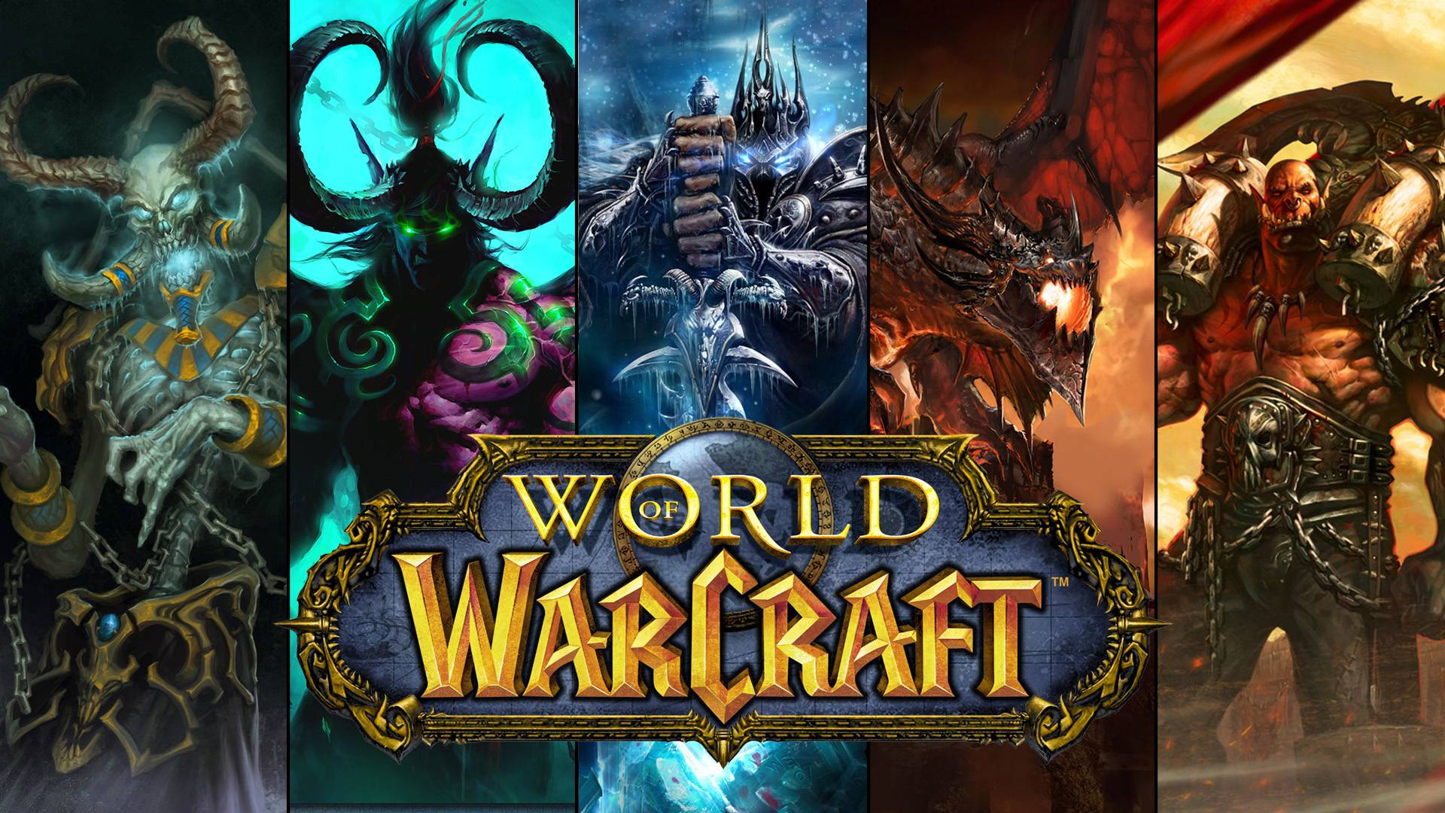

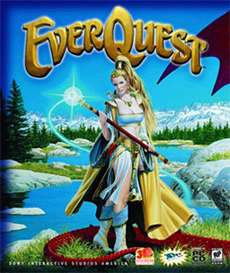


Slide 5
Fighting games
“Games involving characters who fight usually hand-to-hand, in one-to-one combat situations without the use of firearms or projectiles.” (Wolf)
NOT used for games that involve driving or shooting. EX: GTA

Slide 6
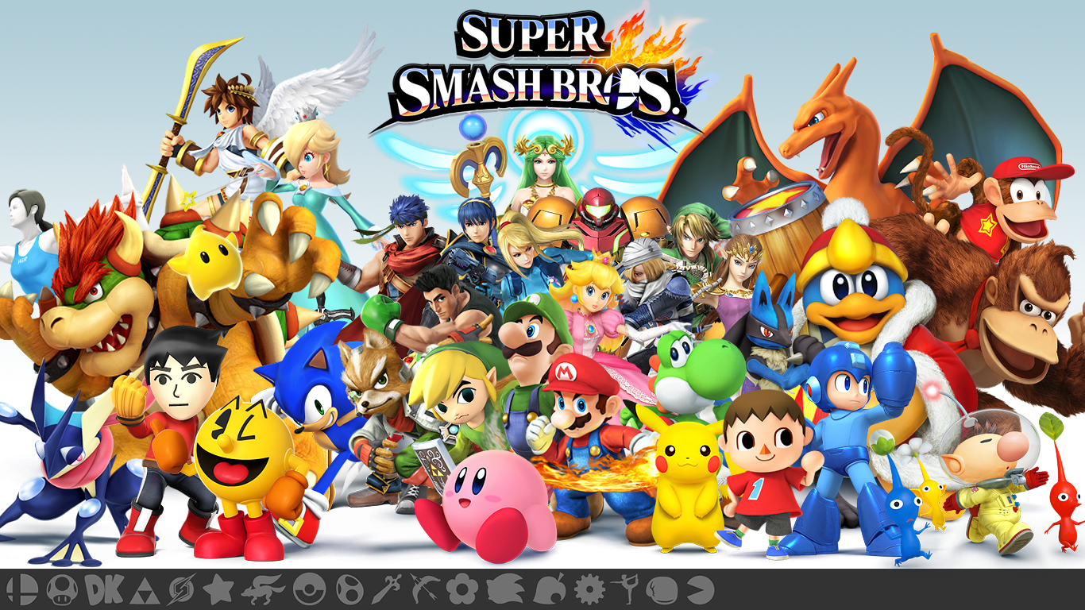




Slide 7
Independent games (Indie/Art)
The goal of indie games is to challenge video game conventions by using aesthetics and jarring visual effects, genre mashing (usually by utilizing earlier genres and styles considered out of date, ie: sidescrollers), messing with perceptions (mostly in the story aspect), and unusual controls/camera.
Challenging. EX: Super Meat Boy https://www.youtube.com/watch?v=mbSDiFihwXs
Affecting. Relies heavily on the emotional aspect of gameplay. Ex: decision based games (like Heavy Rain)
EX: Flower https://www.youtube.com/watch?v=RUC2tpY5gb4
Like with independent films, game companies are free from corporate intervention which allows them to step outside convention.

Slide 8





Slide 9
First Person Shooters (FPSs)
Usually in teams, the player experiences the game world as if they were the character, bridging the gap between reality and the game. (EX: when holding a gun)
Characterized by their complex graphics, programming, and violent content. It is a controversial genre as some believe it cultivates violent behavior.
FPSs force the player to be alert and aware of their surroundings/setting or their character will be at risk.

Slide 10

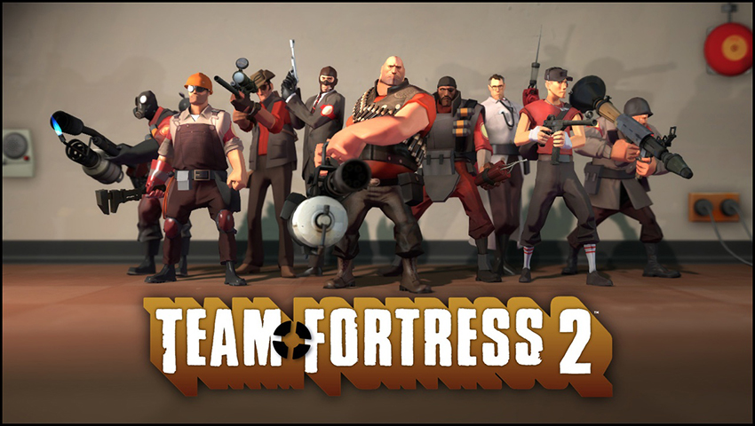
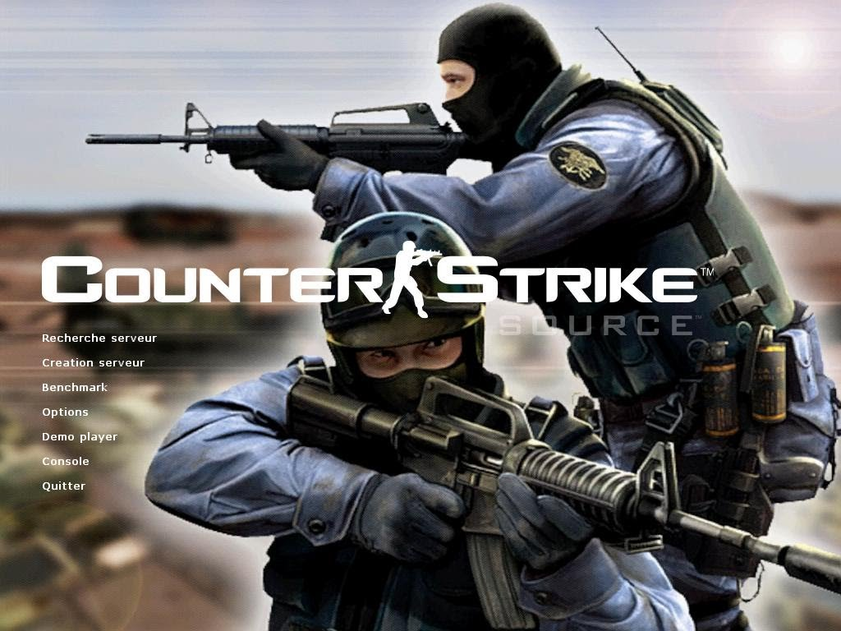


Slide 11
Role-Playing Games (RPGs)
“Games in which players create or take on a character with a developed persona that often has a description often including specifics as species, race, gender, and occupation.” (Wolf). Building a character often includes other aspects such as special abilities (ie: alchemy or supernatural powers) that are unique to the chosen character class. The character drives the story.
Identity is extremely important in these games as well as the finale of the story, which usually has a surprising element (much like a TV show).
RPGs like Fallout, have developed a huge following and are on their 4th installment to the series; the game is held in high esteem for its atmosphere (classic 50-60s setting, but also apocalyptic), intricate story, and character development.
Can be single player or multiplayer, or both (EX: The Last of Us MP)

Slide 12


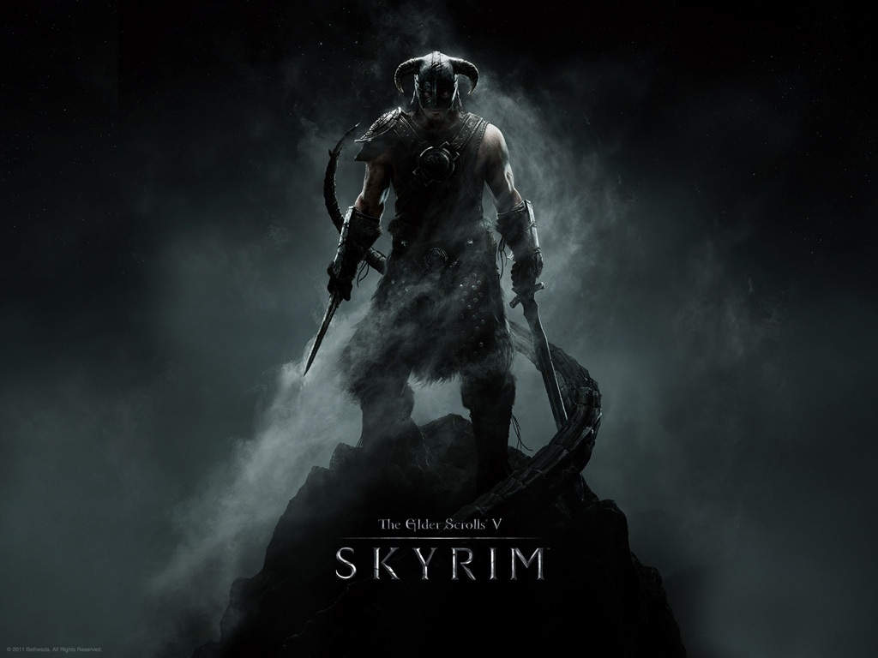
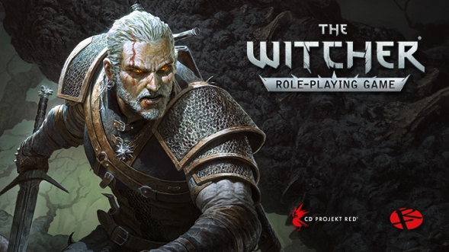

Slide 13
Competitive Gaming
With gaming becoming more advanced, it follows that it has also become more competitive.
Competitive gaming, like MMOs, encourages team play (remotely or in person) in a competition/tournament setting. It requires practice, just like learning piano.
Some players can even make a living off being a competitive gamer

Slide 14


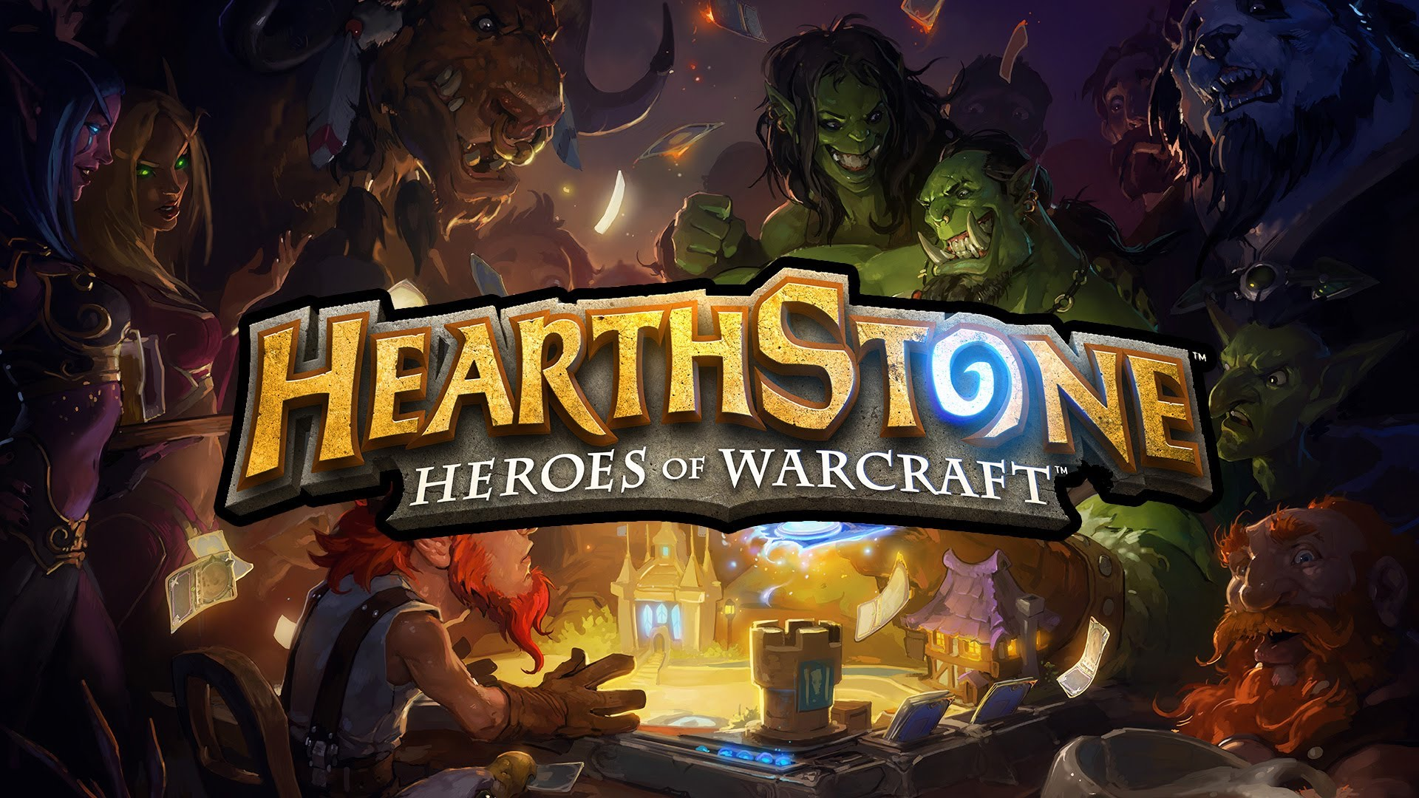


Slide 15
Kinetic-Controlled (aka: Rhythm games)
“Games in which gameplay requires players to keep time with a musical rhythm. These games may employ a variety of controllers beyond the usual video game hardware.” (Wolf)
Requires (and strengthens) quick and accurate hand-eye coordination and reaction time.

Slide 16





Slide 17

Bioshock (RPG+FPS)

Slide 18
Bioshock (RPG+FPS)
A mash-up of sci-fi and horror, Bioshock affects the player on a psychological and philosophical level by implenting aspects of “cognitive science, Philosophy of Mind, hermeneutics (interpretation), video game philosophy, and Philosophy of Free Will” (Cuddy). EX: harvesting Little Sisters
A mix of RPG and FPS as it is a story-driven adventure game you play entirely in first person that focuses heavily on combat/weapons.
Story is a “meta-narrative” because “it encompasses the game narrative as well as the player’s participation in it” (Cuddy). Your interaction with the game is a story, too! Ryan will address the character, but he is really addressing YOU.

