Slide 1
FRANKENSTEIN (1931)
Martin Williams and Spencer Beghtol

Slide 2
(Brief) History of Horror Film Before 1931
German Expressionism
not limited to film (Kirchner, Munch, Kandinsky)
WW1 Europe- low budgets with focus on lighting, set design
heavy stylization, erratic movement, make up
The Golem (1915), The Cabinet of Dr. Caligari (1920), Nosferatu (1922)

Slide 3
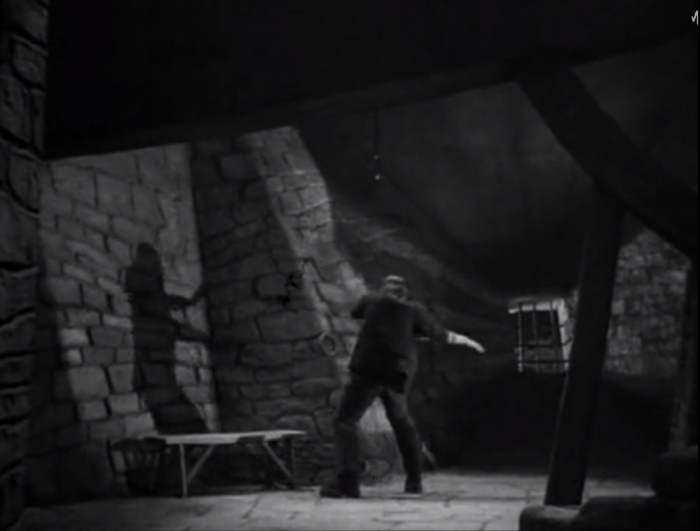
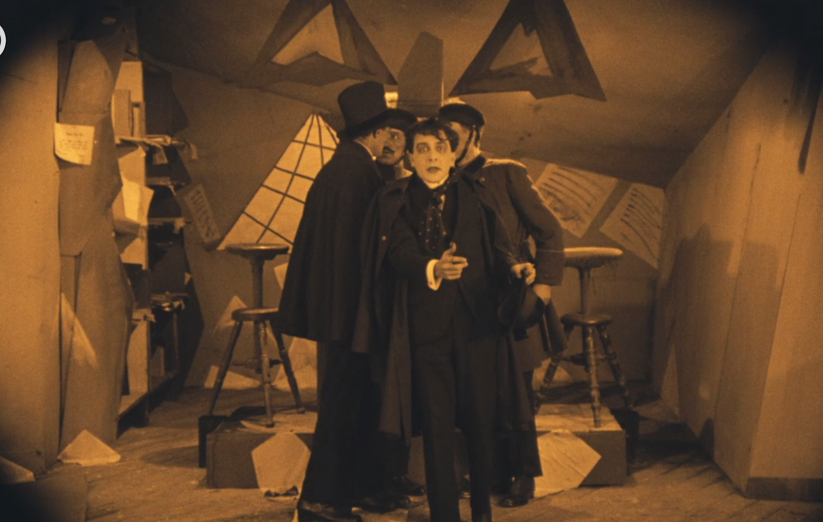
The Cabinet of Dr. Caligari (1920) vs. Frankenstein (1931)

Slide 4
Film vs. Novel
Adapted from the play Frankenstein: An Adventure in the Macabre by Peggy Webling
non epistolary
Introduces assistant Fritz (who promptly dies)
“criminal brain”
Henry (not Victor) and Elizabeth get a happily ever after
Creature is much less sympathetic, can’t speak

Slide 5
Censorship
Release in 1931, Hays Code (Hollywood Production Code) not strictly enforced until 1934
"It's alive! It's alive! In the name of God! Now I know what it feels like to be God!"
Murder of the child Maria
Fritz’s torment of the monster
close up shot of an injection
After 1934 due to Hays Code these scenes were edited out of film because of their shocking and gruesome nature

Slide 6
Sparks Golden Age of Monster Films
Universal’s monster movie niche continued through the 30s all the way to the 50s because of their relatively cheap production value in relation to profits, especially during the Great Depression.
Dracula (1931), Frankenstein (1931), Bride of Frankenstein (1935), Son of Frankenstein (1939), The Mummy (1932), The Werewolf of London (1935), The Wolf Man (1941), etc.

Slide 7
Lasting Impact on Horror Genre & Pop Culture
“It’s alive! It’s alive!”
shambling, arms extended monster posture
mad scientist stereotype, white lab coat
angry mob with torches and search dogs
Parodies/Homages
There have been countless projects influenced by or directly taking from Frankenstein, so much so that there is an entire wikipedia page devoted to listing them. https://en.wikipedia.org/wiki/Frankenstein_in_popular_culture So here are some favorites that we thought were particularluy influential/bizarre.

Slide 8
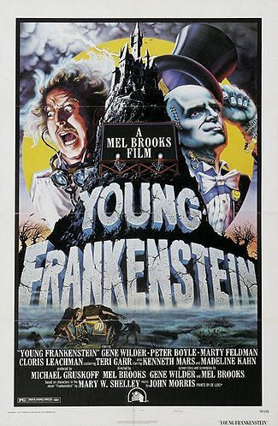
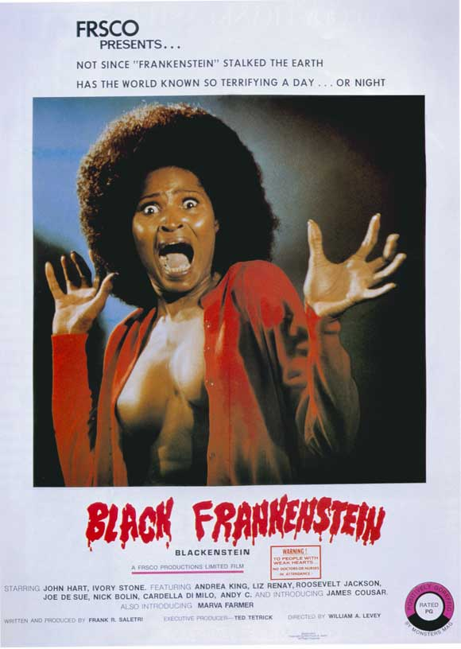
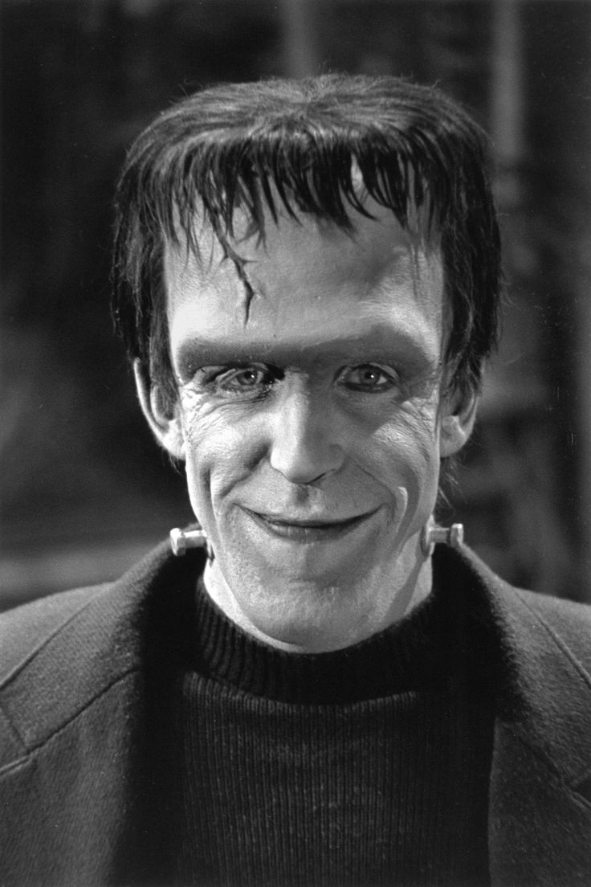
Herman Munster

Slide 9
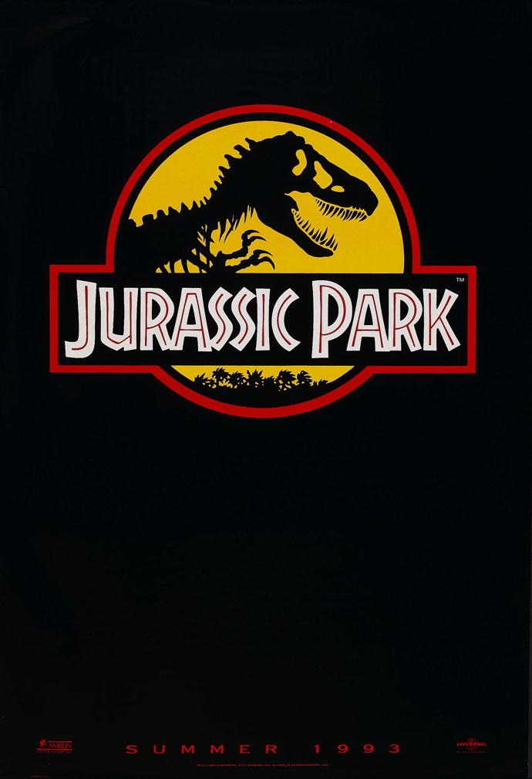
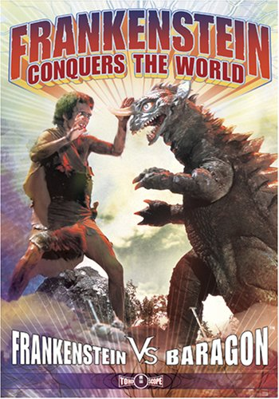
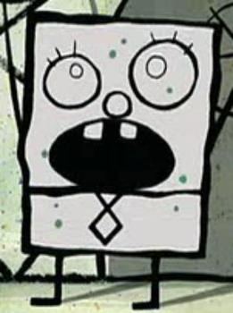
Spongebob

