Slide 1
House of Leaves
Decoding and Celebrating
E314L – Cult Classics
Haley Alexander
Jackson Wu

Slide 2
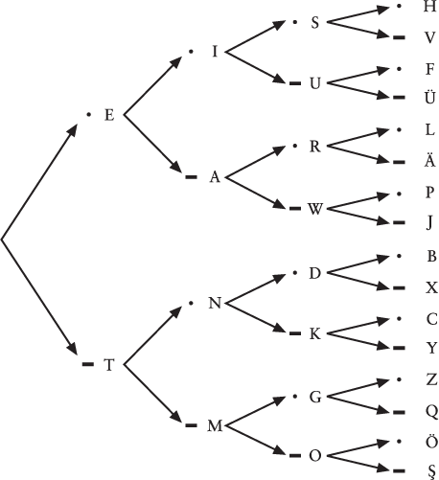
Morse Code
From the invention of the telegraph, Morse code was born.
Known as “dots and dashes” and “dits and dahs”, each character corresponds to a unique sequence.
Primarily found in Chapter VIII. How is the hollow square used?

Slide 3
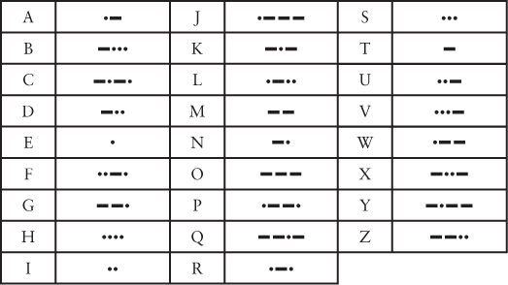
••• − − − •••

Slide 4
Acrostic
Here in Camp Wampano, I feel great.
Everybody seems so nice and friendly.
Later, one of the boys gave me a surprise.
Plastic wrap on toilet, what could go wrong?
Commonly found in poems, the acrostic typically has the first letter in the text spell out another word or message.
Plenty of acrostic codes have been found throughout the novel.

Slide 5
Footnote 75, pages 64-67
On page 64, the footnote has 3 pages of full names that appear starting with “… as well as some of the photographs by Lucien Aigner, Osbert Lam, Cas Oorthuys, Floris M. Neusüss, Ashim Ghosh, …”
Take the first letter of each surname and put it all together…

Slide 6
Footnote 75, pages 64-67
ALONGLIST[o]FVISI[o]NARIESSALUTJWBKVCBNRBBBWPCRP
KAHFECFBGBRLAKFDJUWCWCALSWCSZFPSGBNRSMQBPCEPMWGB
STNBPRMVBGSGPTMRGCCBNKLHDBHMDRHDWMWFLCRMSCDMSKTRSG MK
NETDBPSHESAIDMEMORIESMEANALLBUTTHEYAREALLDEADWHOYOUDGWMSREIRFSKSMG
CWSOWKTBIFHPNBLRBMBCGMMGTHDCTMSHKMLSL
BRSHLWBSGKSBCLSRWHEGBLGLMTLMFSCTPPSHFTCBMBWSCPHMLH MRD
SNBBLTNBPGKWLEHFDBCBMWGBCEYPBSMRBJTHNRCMRZWCHBLRFK ZPS
MBDSJBMIWAITNOWFORONLYTHEWIND
CMGSSFBVCCKDBSKBGWCDMLSCKBCSKOMHSBRWJLLDCZKDFMGMBH B
KHKCHWBSMMNFMCAKNJDKCBLJSHFHLRTPARWSLFBBEBALWBAMHV MRR
MRWCBSBSWSCKDNAKWGKHGHFLMHFJCMKBSBTWBLHFPGGWFWGBFG H
MBBKCDLDSFGLSCKDBWSRBBSTCBSHBSBBSJPSJBCWHSTDBWTGHS PH
UUHDKRTTSRMDHCTLTFSMKTDNKDCWDHHBTHCMTLCEBVHLVNHHHL DHW
BCKKQTSTMSVNKHPTCHTSUHHDHHNCDNNAHBGLGDHKSQBTHNDSML KFL
MTHMTNCWRMTFRDHPTHWVMGJLHKTBFHSDTHLJESDTHMDVAMPNCR GHM
TRRNSMSVHEHLDGKVGDSPBBMHRMCCBAHBM

Slide 7
First letter of every footnote
ASOTILAiMINITDSSMILDAASBDRMARKZDANIELEWSKINFZDAN
IELEWSKITNOWLFJHTTWSKYFPTMYTFSCBSNZSAnTSBMSSLSGS
BSSRCSFIPBMNBRDSNWLSGASTFNNASJTTPHIGFAVITWESHCWT
PAPLSTiI_AGNSFOSFSWSAMITIETHNAAOMIIAWATIYFSSFiST
COWASWMOOWOJRWSTDWFTNSCMISMGWCMKJNSITTAiASSTATEE
WTNFTPLLINOFLIISWMGLEITtTBITMNaTIATTDGDHMSNOSSKA
GPIS_JTFRFIINiRRL0ICAAAPSWSJQCCICMTDAAISKTCASNMC
CWHFMICOTMWSNSASTTRTSTTBOIRMATIAJSDSSWWNQLAGISMR
BPPHSCDSSHISASFTIOTRA_ASJOSCVPTMJTLLISCSLTDPSRRS
PMTNWESPI_HCTPDGSMMDMMSSPSMTTAETQWTWAMABTLWY
ASOTILAiMINITDSSMILDAASBDRMARKZDANIELEWSKINFZDAN
IELEWSKITNOWLFJHTTWSKYFPTMYTFSCBSNZSAnTSBMSSLSGS
BSSRCSFIPBMNBRDSNWLSGASTFNNASJTTPHIGFAVITWESHCWT
PAPLSTiI_AGNSFOSFSWSAMITIETHNAAOMIIAWATIYFSSFiST
COWASWMOOWOJRWSTDWFTNSCMISMGWCMKJNSITTAiASSTATEE
WTNFTPLLINOFLIISWMGLEITtTBITMNaTIATTDGDHMSNOSSKA
GPIS_JTFRFIINiRRL0ICAAAPSWSJQCCICMTDAAISKTCASNMC
CWHFMICOTMWSNSASTTRTSTTBOIRMATIAJSDSSWWNQLAGISMR
BPPHSCDSSHISASFTIOTRA_ASJOSCVPTMJTLLISCSLTDPSRRS
PMTNWESPI_HCTPDGSMMDMMSSPSMTTAETQWTWAMABTLWY

Slide 8
“Letter” Play
Letter-cipher
  Assign every letter in the alphabet a number starting from 1. A=1, B=2, C=3, … Z = 26
  Consider the names, Johnny and Zampano
  J = 10, O = 15, H = 8, N = 14, N = 14, Y = 25
  Z = 26, A = 1, M = 13, P = 16, A = 1, N = 14, O = 15
  Johnny sums to 10+15+8+14+25 = 86
  Zampano sums to 26+1+13+16+1+14+15 = 86
  Why 86? From the Oxford English Dictionary, it is a U.S. slang word used in restaurants and bars. It can mean a customer is not to be served or to eject a person from the premises.

Slide 9
“Letter” Play
On pg. 621, some words are randomly capitalized.
  elevAted, nulliFied, embArked, deCeased, evEry, decIdes, kiNd, iAmbs, …
  Putting it all together, it forms:
  A FACE IN A CLOUD NO TRACE IN THE CROWD

Slide 10
“Letter” Play
On pg. 626, a letter is written to Johnny.
Yack! Again these dark ribbons wrap me up like a present, a
cHrIStmas present, this present, never found, never opened.
Tossed like a doll. Spanish.
  Putting it all together, YAHISTS. An convenient anagram for THIS SAY.
Of course. Dell’oro, del oro, deloro.
The ripe earth yawns daily to swallow me. I continued this pattern with the last line. Love’s love in her blackest season,
    This gives ODTreysdtoswmeLslinhrbtsn
THIS SAY(s myths when TOLD restore blind eyes)

Slide 11
What does it all mean?
Haunted House - An Interview with Mark Z. Danielewski
On the authentic narrator
  “There is no sacred text here.” “…everything we encounter involves an act of interpretation on our part”
On interpreting features of House of Leaves
  “I’m simply unwilling to compromise the thrill that comes when a reader privately uncovers a meaning not yet circulated. It is an experience both intimate and profound, and one I’ve personally relished my entire life.”

Slide 12
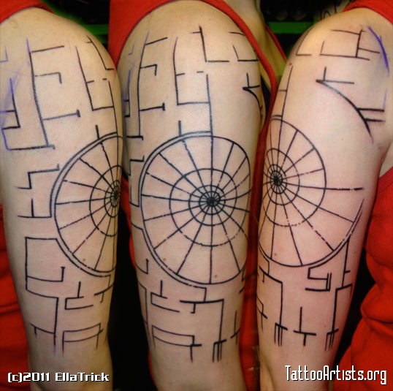
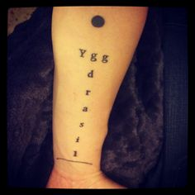
Online Fan Base
Avid cult following
The Navidson Record’s fictitious cult following

Slide 13
Interaction with Novel
What purpose do these online communities serve?
House of Leaves: Reading the Networked Novel (Jessica Pressman)
“A print novel for the digital age”
Online discourse as intended part of reading experience

Slide 14
Online sources
House of Leaves Forum: http://forums.markzdanielewski.com/forum/house-of-leaves
Definitions from Oxford English Dictionary: http://www.oed.com/
Images from Code: The Hidden Language of Computer Hardware and Software – Charles Petzold (Chapter 2)
Tattoo Images: Yggdrasil Tattoo. Digital image. Typographic Tattoos. Tumblr, n.d. Web. ; Trick, Ella. House of Leaves Blueprint Tattoo. Digital image. TattooArtists.org. N.p., 2011. Web.

